Slide 1


COURSE NAME:MATHEMATICAL OPTIMIZATION
CODE:24MT2012
Topic: Optimization Problems & Applications Across Disciplines
CO1: Session - 01

Slide 2



AIM OF THE SESSION
To explore optimization problems and their diverse applications across disciplines through mathematical optimization techniques..
INSTRUCTIONAL OBJECTIVES
This Session is designed to:
Define the concept of optimization and classify different types of optimization problems.
Explain the mathematical formulation of optimization problems including objective functions and constraints.
Identify key challenges in solving nonlinear optimization problems.
Analyze real-world applications of mathematical optimization across various disciplines such as engineering, economics, computer science, and healthcare.
Evaluate suitable optimization techniques for specific interdisciplinary problems.
LEARNING OUTCOMES
At the end of this session, the students should be able to:
Understand the fundamental concepts and types of optimization problems, including linear, nonlinear, integer, and dynamic programming.
Evaluate the advantages and limitations of optimization techniques such as convex optimization, genetic algorithms, and mixed-integer programming.

Slide 3
Syllabus
CO1: Introduction to Optimization: Types of optimization problems, Applications across disciplines. Linear Programming: Formulation of LP Problem (LPP), Graphical method, Simplex method.(maximization and minimization) Duality concept in LPP. Transportation problem, Assignment method.
CO2:, Integer Programming, Branch & bound algorithms, valid inequalities & cut plane method. Constrained optimization: Gradient descent Newton's method Conjugate gradient method.
CO3: Non-Linear Programming : Quadratic programs – Constrained quadratic programming problems, Beale’s method, Wolfe method, Karush-Kuhn Tucker (KKT) Conditions. Geometric Programming: Problems with one-degree of difficulty with positive coefficients, Geometric programming with constraints, Problems with positive and negative coefficients.
CO4: Infinite Dimensional Optimization: Heuristic and Meta heuristics, Single solution vs. population-based, Evolutionary algorithms Genetic Algorithm, Trajectory algorithms- Simulated annealing, Tabu search. Nature- inspired metaheuristics-Ant-colony optimization, Particle swarm optimization
Notes:
3

Slide 4
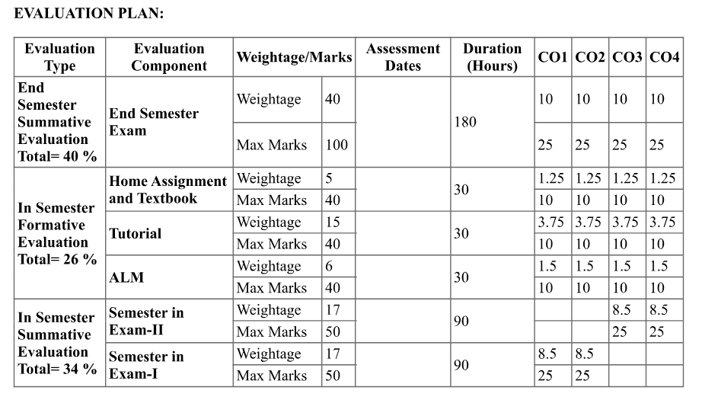
Evalution plan
Notes:
4

Slide 5
MooCs Course Links
https://www.coursera.org/learn/operations-research-modeling
https://www.coursera.org/learn/operations-research-algorithms
https://www.coursera.org/learn/operations-research-theory
Notes:
3

Slide 6
What is an Optimization Problem
An optimization problem is a mathematical problem of finding the best solution from a set of feasible solutions. It typically involves:
Objective Function: A function to be maximized or minimized.
Decision Variables: The variables that affect the outcome.
Constraints: Conditions that must be satisfied.
Notes:
6

Slide 7
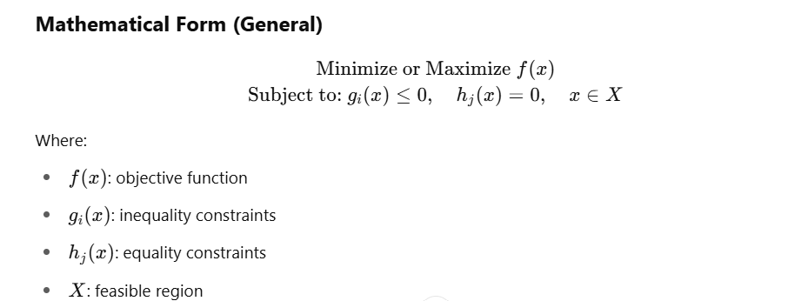
Mathematical Form (General)
Notes:
4

Slide 8
Types of Optimization Problems
Linear Programming (LP): Objective and constraints are linear.
Nonlinear Programming (NLP): At least one nonlinear component.
Integer Programming (IP): Variables restricted to integers.
Dynamic Programming: Sequential decision-making.
Convex Optimization: Convex objective and feasible region.
Stochastic Optimization: Deals with uncertainty in data.
Combinatorial Optimization: Deals with discrete structures.
Notes:
5

Slide 9
Types of Optimization Problems
A. Classical Techniques
Linear Programming (LP): Solves problems with linear objective functions and linear constraints.
Integer Programming (IP): Optimization where variables are constrained to take integer values.
Nonlinear Programming (NLP): Deals with problems having nonlinear functions.
Gradient Descent: An iterative method that uses gradients to find local minima.
Notes:
6

Slide 10
Types of Optimization Problems
B. Heuristic and Metaheuristic Techniques
Genetic Algorithms (GA): Inspired by natural selection, used for complex and non-differentiable problems.
Simulated Annealing (SA): Mimics the annealing process in metallurgy.
Particle Swarm Optimization (PSO): Based on the movement of bird flocks or fish schools.
Ant Colony Optimization (ACO): Inspired by the behavior of ants searching for food.
Notes:
7

Slide 11
Applications Across Disciplines
A. Engineering
Civil/Mechanical Engineering: Design optimization of structures (e.g., trusses, bridges).
Electrical Engineering: Circuit design, power flow optimization.
Control Systems: Optimal control for dynamic systems.
B. Computer Science
Machine Learning: Model training (e.g., minimizing loss function).
Scheduling: Job-shop and task scheduling.
Network Design: Routing, bandwidth allocation, load balancing.
Notes:
8

Slide 12
Applications Across Disciplines….
C. Operations Research
Logistics: Supply chain optimization, vehicle routing.
Resource Allocation: Staff scheduling, inventory management.
Project Management: Critical path and cost minimization.
D. Economics & Finance
Portfolio Optimization: Maximize returns, minimize risk.
Game Theory: Nash equilibria, strategic decisions.
Pricing Models: Revenue maximization under constraints.
Notes:
9

Slide 13
Applications Across Disciplines….
E. Healthcare
Radiation Therapy Planning: Optimize dosage while minimizing damage to healthy tissue.
Hospital Resource Allocation: Beds, staff, and equipment optimization.
F. Environmental Science
Energy Optimization: Renewable energy allocation, grid optimization.
Water Resource Management: Irrigation planning, reservoir management.
G. Telecommunications
Signal Processing: Filter design, error correction.
Network Optimization: Maximizing throughput, minimizing latency.
Notes:
10

Slide 14
TERMINAL QUESTIONS
Write the steps of converting a minimization problem to a maximization problem.
List the steps of optimization following the Simplex method.
Define the following terms:
  Pivot element
  Slack variable
  Basic variable
In simplex method, what is the criterion to decide whether the optimality is reached?
Notes:
11

Slide 15
Real-World Case Examples
Google Maps: Uses optimization algorithms for shortest path.
Amazon: Uses optimization in warehouse logistics and delivery routing.
Finance: Algorithms for real-time trading optimize portfolios.
Notes:
12

Slide 16
Conclusions
Mathematical optimization is a fundamental tool that cuts across disciplines.
It provides the framework to model, solve, and interpret real-world decision-making problems effectively and efficiently.
Notes:
13

Slide 17
Terminal Questions
1. Which of the following is an example of a linear programming problem?
Minimizing a nonlinear function with multiple local minima
B. Allocating limited resources to maximize profit under linear constraints
C. Training a neural network using gradient descent
D. Solving a differential equation for dynamic systems
2. In which of the following fields is mathematical optimization commonly used?
Operations research
B. Economics
C. Engineering design
D. All of the above
Notes:
14

Slide 18
Textbook References
Introduction to Operations Research"
Authors: Frederick S. Hillier and Gerald J. Lieberman
Publisher: McGraw-Hill
Highlights: Covers linear, nonlinear, integer, and dynamic programming. Very detailed and application-oriented.
Moocks:
Link: https://www.coursera.org/learn/mathematical-optimization
Content: Linear programming, convex optimization, and duality. Beginner friendly.
2. [Discrete Optimization – Coursera (University of Melbourne)]
Link: https://www.coursera.org/learn/discrete-optimization
Content: Constraint programming, integer programming, local search.
Notes:
15

